Slide 1

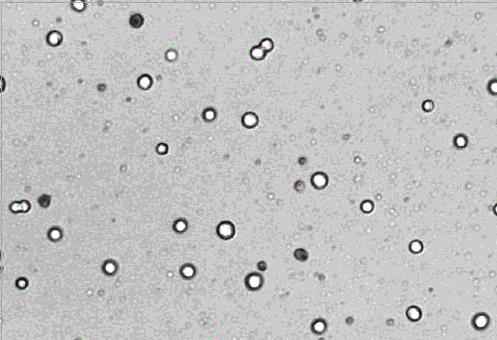
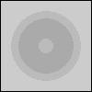
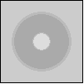
Adapting Vi-CELL XR cell counter methods to the complexity of perfusion cell culture
Zayla Schaeffer,¹ Jimmy Vu,¹ Andrea Squeri,¹ Ken Lee¹
¹BioProcess Technologies & Engineering, BioPharmaceuticals Development, R&D, AstraZeneca, Gaithersburg, MD
Abstract
Methods
Previously, micelle presence began impacting VCD accuracy around day 7 (mid-experiment) and worsened through end of culture (Fig 2A). The VCD reported by the Vi-CELL XR could be up to or greater than 100%, or twice as great as the BioProfile® FLEX2 VCD, which excludes micelles. The new perfusion-specific cell counting method brought the percent difference to generally between ±15%, which was the goal of this project. There is a noticeable trend in the percent difference shown in Fig 2B, indicating that not all sources of variation were removed; however, some of this variation may be due to other factors such as error introduced during manual vs automatic dilution.
The future of biopharmaceuticals lies in adoption of continuous manufacturing, requiring higher concentrations of cell culture and substantial changes to the ways we think about molecule production. However, it is important to be able to quantify perfusion cell cultures by the same metrics as standard fed-batch cultures, including peak viable cell density (VCD), end-of-run VCD, and end-of-run viability. This becomes especially important if the bioreactor control strategy relies on accurate VCD measurements to maintain stationary phase. However, antifoam demand and various stresses of perfusion culture create an abundance of micelles that can be mis-identified as live or dead cells by cell counter instruments. As the culture declines, micelles can outnumber live cells and substantially impact the VCD measurement. Additionally, cell counter instruments like the Beckman Vi-CELL XR and Nova Biomedical BioProfile® FLEX2 see micelles with different definition, resulting in disagreement over whether to count the micelles.
Through the reanalysis of data from multiple CHO cell line experiments, a new cell counter method was created for Vi-CELL XRs to exclude micelles and align with the BioProfile Flex2. This new perfusion-specific cell counter method brought the VCD difference between the Vi-CELL XR and BioProfile® FLEX2 to within ±15% and has since been deployed for all perfusion cell culture experiments.
Gathering cross-samples
CHO cell culture from several perfusion experiments was analyzed on both BioProfile® FLEX2 and Vi-CELL XR
Generating potential cell count methods
3 representative samples from mid- to end-of-run culture were selected for reanalysis
Cell count method parameters adjusted to determine impact on counting accuracy
Accuracy quantified by manual counting of mis-identified particles
4 different method candidates identified
Testing method candidates on additional samples
Samples representing all stages of perfusion culture were selected for Vi-CELL XR reanalysis with the 4 method candidates
VCD and viability results from reanalysis were compared to BioProfile® FLEX2 data
The method candidate which best balanced VCD and viability accuracy was selected to be the new perfusion cell count method
Deployment and confirmation
The perfusion cell count method was used on all perfusion cell culture, and over 500 samples were collected to confirm agreement between Vi-CELL XR and BioProfile® FLEX2
A
C
B
Results
D
Table 1. Vi-CELL XR cell count method parameters for original and new perfusion-specific method
 | Original method | New Perfusion method
Min diameter | 6 | 10
Max diameter | 50 | 35
Cell brightness | 85 | 86
Cell sharpness | 100 | 53
Viable cell spot brightness | 75 | 85
Viable cell spot area | 5 | 11
Minimum circularity | 0 | 0.3
Decluster degree | Medium | Medium
Number of images | 50 | 50
Representative live cell image in Vi-CELL XR interface
Introduction
Fig 3. Agreement between Vi-CELL XR and Nova BioProfile FLEX2 on A) VCD and B) viability since implementation of new perfusion-specific cell counting method. Histograms of VCD difference (%) C) and viability difference D) are included.. The orange line represents y=x.
Micelles, which are particulates formed from antifoam and/or cell debris, are common in perfusion culture and can be mis-identified as live or dead cells by cell counting instruments depending on the cell counter method.
Micelles were observed to substantially impact the Vi-CELL XR end-of-run VCD by up to or greater than 100% in some cases
Inaccurate VCD measurements can impact peak VCD, end-of-run VCD and viability, as well as apparent per-cell productivity and cell-based feeding strategies. They also make it difficult to replicate growth curves between bioreactors and experiments and across types of cell count analyzers
Through repeated reanalysis of CHO cell line experiments, a mew method was created for the Vi-CELL XR to bring VCD measurements within ±15% of the BioProfile® FLEX2
After full deployment, over 500 samples representative of all stages of perfusion culture were collected to confirm the agreement between Vi-CELL XR and BioProfile® FLEX2. The findings from these samples are:
VCD is strongly correlated, with Vi-CELL XR measurements just 4% greater on average
Viability matches closely above 60%, while below 60% the BioProfile® FLEX2 measures higher viabilities on average
Conclusions
The perfusion-specific cell counting method created for the Vi-CELL XR successfully excludes micelles from its live and total cell counts, allowing the Vi-CELL XR to match the BioProfile® FLEX2 to within ±15%
Further testing of the perfusion-specific method has shown Vi-CELL XR VCDs are just 4% greater on average than those from the Nova BioProfile FLEX2
Deploying the perfusion-specific method for development has produced more accurate per-cell productivities and feeding strategies, as well as more realistic end-of-run VCD and viability data that can be compared between runs
The perfusion-specific method will be transferred with perfusion processes entering manufacturing
A
Fig 1. Image from Vi-CELL XR: live cells are marked in green, dead cells are marked in red, and micelles that were originally counted as live or dead cells are marked in blue
B
Fig 2. Percentage difference in VCD between the Vi-CELL XR and BioProfile® FLEX2 for CHO perfusion culture using A) the original Vi-CELL XR cell counting method and B) the new perfusion-specific method. Note the difference in Y-axis scale.
Calculation is (VCD_{ViCell}-VCD_{Nova}) / VCD_{Nova}*100%
Acknowledgements
BioProcess Technology and Engineering team and ambr250 team at AstraZeneca
Nova Biomedical and Beckman Coulter technical support
Supported by
Presented at BioProcess International, Boston Exhibition and Convention Center, 27-30 September 2022

